Slide 1
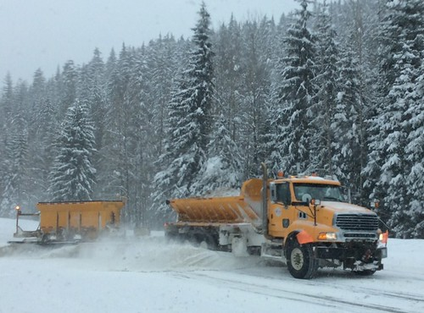
Pennington County Highway Department Overview Entry-Level Driver Training Program for (CDL) operators
Notes:
Image Source: Clear Roads

Slide 2
Origins
Why?
Studies proved that accidents and violations were significantly less for operators that were properly trained and certified. Based on this criterion, the Federal Motor Carrier Safety Administration (FMCSA) implemented federally mandated training for all new drivers.
What?
ELDT (Entry Level Driver Training) regulation for CDLs
How?
Specified program of instruction which covers regulation for CDL’s
Theory and Behind the Wheel (BTW)
Applies to:
First time CDL applicants (Class A or B)
Upgrade to a Class A or Class B CDL
Hazardous Materials, Passenger, and School Bus Endorsements

Slide 3
Compliance Date: February 7, 2022
New CDL’s only issued to persons completing federally compliant training
Training must include all required Theory (classroom) content
Training must include all required BTW (behind the wheel) training
Training must include and document comprehensive testing/assessment
Training data must be reported to the Federal Motor Carrier Safety Administration (FMCSA)

Slide 4
Summary of major provisions
ELDT Rule is found in 49 CFR part 380
(Code of Federal Regulations)
Known as the Federal Motor Carrier Safety Regulations.
Applies to both intrastate and interstate drivers.
Established curriculum is subdivided into Theory and BTW.
Theory and BTW may be provided by different training providers or at different training sites, as applicable.
Training materials follow the information presented in the following publications:
“South Dakota Commercial Drivers License Manual”
“SD DOT Commercial & Agricultural Vehicle Handbook”
Notes:
Image Source: Ohio DOT

Slide 5
Training Providers
Individual who provides knowledge instruction on the operation of a CMV and meets one of these qualifications:
Holds CDL of same or higher class, 2 years CMV driving experience & meets state requirements for a CMV instructor
Holds CDL of same or higher class, 2 years experience as a CMV instructor & meets state requirements for a CMV instructor
Is prohibited from engaging in BTW instruction, for 2 years, if CDL has been cancelled, suspended or revoked for any disqualifying offense (§ 383.51)
Must provide instruction in a curriculum that meets the ELDT rule
Must meet eligibility requirements to be listed on the Training Provider’s Registry (TPR)
Must attest that they meet the requirements
Must be able to supply records and documentation in the event of a FMCSA audit

Slide 6
Theory Instruction (classroom)
No minimum number of hours on theory units, however…
Instruction in all required elements of theory must be provided
Comprehensive testing/assessment must be conducted
Trainees must score a minimum of 80% overall score on theory test(s)
All test results are maintained as verifiable records.
Notes:
Image source: This Photo by Unknown Author is licensed under CC BY-SA

Slide 7
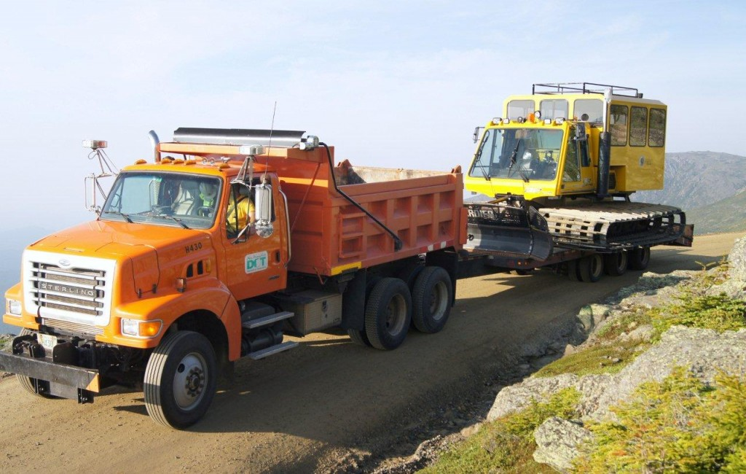
Curriculum Structure – Section 1.1 theory
Section A/B1.1 - Basic Operation​
Unit A/B1.1.1 - Orientation​
Unit A/B1.1.2 - Control systems/dashboard​
Unit A/B1.1.3 - Pre- and post-trip inspections​
Unit A/B1.1.4 - Basic control​
Unit A/B1.1.5 - Shifting/operating transmissions​
Unit A/B1.1.6 - Backing and docking​
Unit A/B1.1.7 - Coupling and uncoupling (Class A CDL only)
Notes:
Image source: New Hampshire State Parks

Slide 8
Curriculum Structure – Section 1.2 theory
Section A/B1.2 – Safe Operating Procedures
Unit A/B1.2.1 – Visual Search
Unit A/B1.2.2 - Communication
Unit A/B1.2.3 – Distracted Driving
Unit A/B1.2.4 – Speed Management
Unit A/B1.2.5 – Space Management
Unit A/B1.2.6 – Night Operation
Unit A/B1.2.7 – Extreme Driving Conditions
Notes:
Image source: This Photo by Unknown Author is licensed under CC BY

Slide 9
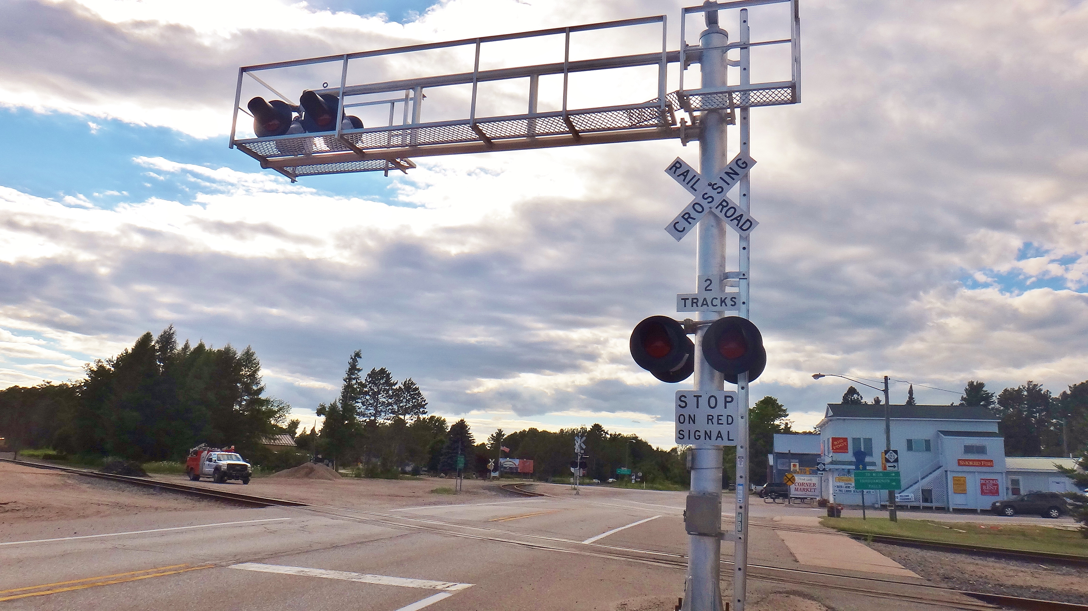
Curriculum Structure – Section 1.3 and 1.4 theory
Section A/B1.3 – Advanced Operating Procedures
Unit A/B1.3.1 – Hazard Perception
Unit A/B1.3.2 – Skid Control/Recovery, Jackknifing and Other Emergencies
Unit A/B1.3.3 – Railroad-Highway Grade Crossings
Section A/B1.4 – Vehicle Systems and Reporting Malfunctions
Unit A/B1.4.1 – Identification and Diagnosis of Malfunctions
Unit A/B1.4.2 – Roadside Inspections
Unit A/B1.4.3 – Maintenance
Notes:
Image source: This Photo by Unknown Author is licensed under CC BY-SA

Slide 10
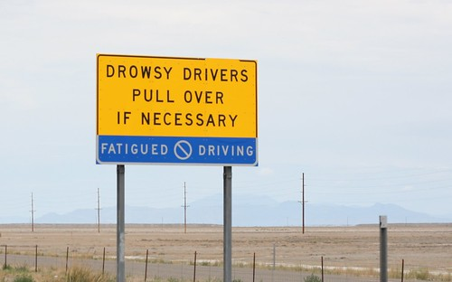
Curriculum Structure – Section 1.5 theory
Section A/B1.5 – Non-Driving Activities
Unit A/B1.5.1 – Handling and Documenting Cargo
Unit A/B1.5.2 – Environmental Compliance Issues
Unit A/B1.5.3 – Hours of Service Requirements
Unit A/B1.5.4 – Fatigue and Wellness Awareness
Unit A/B1.5.5 – Post-Crash Procedures
Unit A/B1.5.6 – External Communications
Unit A/B1.5.7 – Whistleblower/Coercion
Unit A/B1.5.8 – Trip Planning
Unit A/B1.5.9 – Drugs/Alcohol
Unit A/B1.5.10 – Medical Requirements
Notes:
Image source: This Photo by Unknown Author is licensed under CC BY-SA

Slide 11
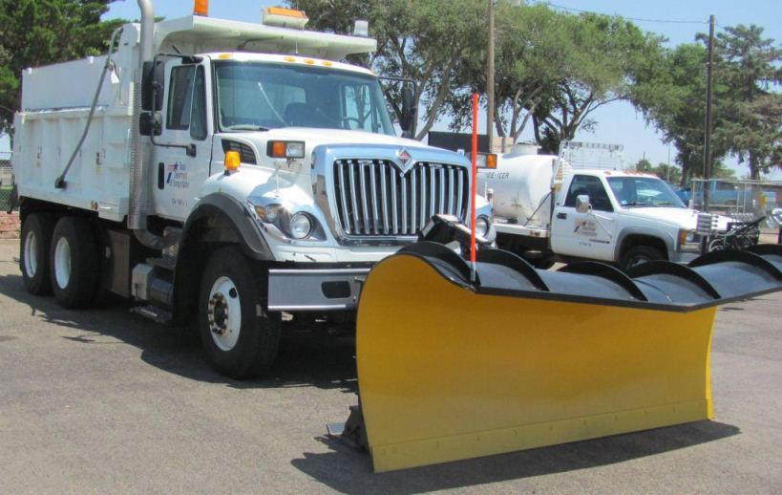
BTW Range and Public Road Training Definition
BTW Training means Active Control
Training provided by a BTW instructor with an Entry-Level-Driver-Trainee requires that actual control of the power be given to the student during a driving lesson.
BTW training does not include time an Entry-Level-Driver-Trainee spends observing the operation of a CMV when he or she is not in control of the vehicle.
Notes:
Image source: Texas DOT

Slide 12
Curriculum Structure BTW range
Section A/B2 – Behind-The-Wheel - Range
Unit A/B 2.1 – Vehicle Inspection Pre-trip/Enroute/Post-trip
Unit A/B 2.2 – Straight Line Backing
Unit A/B 2.3 – Alley Docking (45/90 degree)
Unit A/B 2.4 – Off-Set Backing
Unit A/B 2.5 – Parallel Parking Blind Side
Unit A/B 2.6 – Parallel Parking Sight Side
Unit A/B 2.7 – Coupling and Uncoupling (Class A Only)

Slide 13
Curriculum Structure Behind –The-wheel – public road
Section A/B3 – Behind-The-Wheel – Public Road
Unit A/B 3.1 – Vehicle Controls
Unit A/B 3.2 – Shifting/Transmission
Unit A/B 3.3 – Communications/Signaling
Unit A/B 3.4 – Visual Search
Unit A/B 3.5 – Speed and Space Management
Unit A/B 3.6 – Safe Driver Behavior
Unit A/B 3.7 – Hours of Service Requirements
Unit A/B 3.8 – Hazard Perception
Unit A/B 3.9 – Railroad-Highway Grade Crossing
Unit A/B 3.10 – Night Operation
Unit A/B 3.11 – Extreme Driving Conditions
Unit A/B 3.12 - Skid Control/Recovery, Jackknifing and Other Emergencies

Slide 14
BTW Instruction
No minimum number of hours on BTW units, however…
Instruction in all required elements of BTW training must be provided
Driver-trainees must demonstrate proficiency in all BTW requirements
**Proficiency means repeated demonstration of each required** skill (i.e... No “One & Done”)
Suggested time frame for lessons are provided
Documentation of each practical exercise is completed daily

Slide 15
Training certification
After an individual completes training the provider must, by midnight of the second business day after the driver-trainee completes the training, electronically transmit training certification information through the TPR website (Training Providers Registry) including the following:
Driver-trainee name, number of driver’s license/commercial learner’s permit/commercial driver’s license, as applicable, and State of licensure;
Commercial driver’s license class and/or endorsement and type of training (theory and/or BTW) the driver-trainee completed;
Total number of clock hours the driver-trainee spent to complete BTW training, as applicable;
Name of the training provider and its unique TPR identification number; and
Date(s) of successful training completion.

Slide 16
Pennington County Highway Department
All new hires without a valid class A CDL are scheduled to complete the training program.
The CDL course is based on 240 hours of instruction. (80 hours classroom and 160 (+/-) hours behind the wheel.
New hire must have basic testing and learners permit from SD DMV by the first day of employment.
It is expected that new hires complete the training program, successfully pass the DMV evaluation and acquire a Class A CDL license within 90 days of employment.

Slide 17
BEHIND THE WHEEL TRAINING LOG

Slide 18
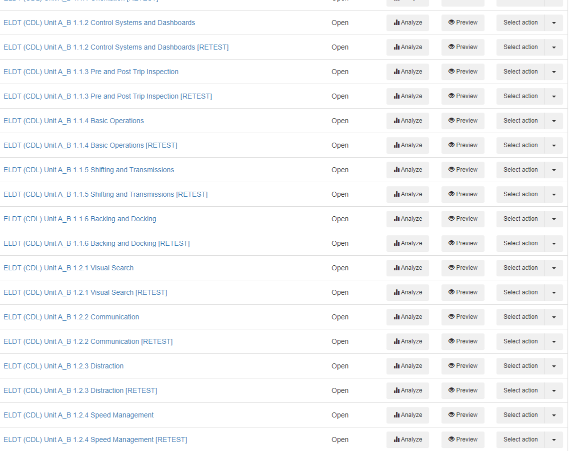
FLEXIQUIZ

Slide 20
Questions?

